Slide 1
Tic Tac Toe
By SHAJT

Slide 2
Detailed Design
Pseudo Code

Slide 3
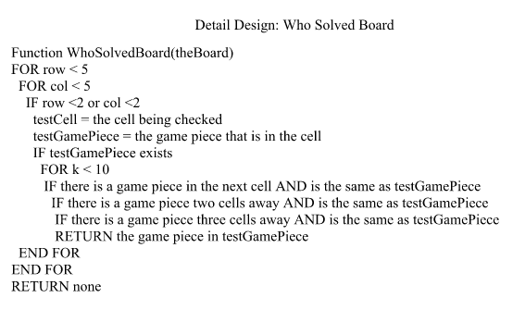
Pseudo Code

Slide 4
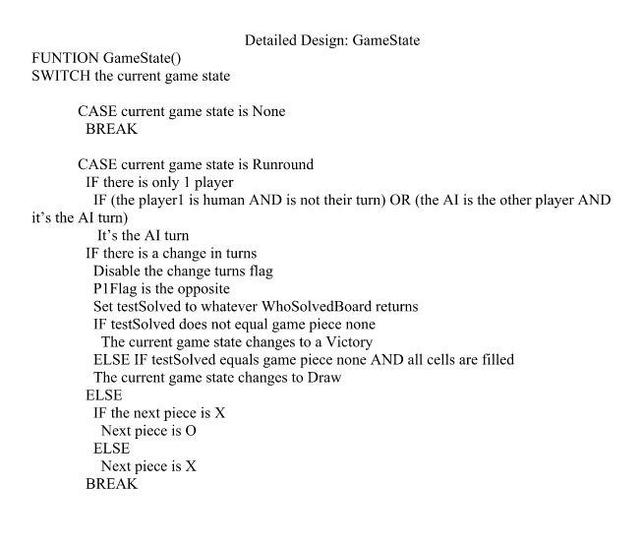

Slide 5
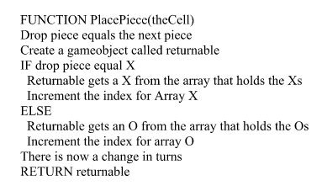

Slide 6
Test Plan
Testing Strategy
Test Scores
Unit, Integration, Job Stream, Interface, Regression Testing

Slide 7
Non Execution Testing
Inspection and Walkthrough
The whole group was involved
1 or 2 persons responsible for making changes to documents
Group decides unanimously if changes made to document are acceptable

Slide 8
Test Strategy
Type of Test | Category | Responsibility
Unit Testing | White and Black Box | Developer
Integration Testing | White and Black Box | Developer
Job Stream Testing | Black Box | SQA
Interface Testing | Black Box | SQA
Beta Testing | Black Box | Client and Group
Regression Testing | Black Box | Developer and SQA
Acceptance Testing | Black Box | Client

Slide 9
Test Scores
A total of 33 Test Cases
28 passed
5Failed

Slide 10
Unit Testing
All modules were tested by developers
Examples:
Profile Loader: Profile save, profile load, profile display
Game Manager: Game States, Check Board, Change turns, Turn AI on
AI: Changing depth search, Calculating moves, Placing pieces

Slide 11
Integration
All integration tested by developers
Examples Include:
Switching Game Pieces – ensure players pieces alternate on clicks
Choose opponent – ensure UI decisions reflect in Game Manager
Placing a Game Piece on Board – ensure the piece places, graphically, state change, and victory conditions are checked

Slide 12
Job Stream Testing
Tested the prototype in the computers of University of Houston-Downtown computer lab.

Slide 13
Interface Testing
Test interface against requirements and specification’s user interface
Test all the buttons on all screens.
Click all cells on the game grid
Entering a new user name
Tested Profile Loader sequence, Game Rounds sequence and AI sequence

Slide 14
Regression Testing
After doing all applicable test cases, SQA reports back all the errors to developer
Developer makes changes and reports all changes back to SQA
SQA applies all test cases to the corrected code and make sure everything still works

Slide 15
Test Cases
Test that user can play against AI in Easy Mode, confirm turns change, and AI places a piece - Passed
User was able to play a against AI in easy mode for multiple rounds
Resolution:
Press the quit button while user plays against AI on any difficult, return to main menu – Failed
Quit button responds, but does not reset board for next round
Resolution: Added reset board reflexes to the Quit button

Slide 16
Test Cases
While in in 2 player mode, player 1 presses “Turn on AI button”. AI plays against player 2 until round ends- Passed
Player 1 pressed “Turn on AI” and player 2 was able to play against AI until the round was finished.
Resolution:
Game record updates after each game round - Failed
Game records does not load correctly when view in Match History immediately after a round, they do appear after a quit/reopen of the game.
Resolution: Forced the Match History screen to reload all match histories and recalculate as it does on first load.

Slide 17
Released Product

